Slide 1
Spirituality and persons with profound intellectual disabilities…
lens

Slide 2
“Severely mentally handicapped people are denied the very substance of a rational productive existence...Such an existence gives no real opportunity for inner spiritual growth, or the nourishment of the human spirit, both of which are important when coming to terms with the meaning of Christianity. It gives no real opportunity to experience the joy of seeking a lifetime relationship with the Almighty, because concepts involved are complicated and require a level of awareness which the profoundly mentally handicapped do not have.” Birchenall
Dr Jill Harshaw Queen’s University Belfast

Slide 3
Initial tensions
Labels
Generalising
Speaking about v speaking for

Slide 4
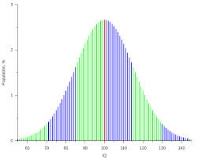
Intelligence Quotient
People with profound
intellectual disabilities

Slide 5
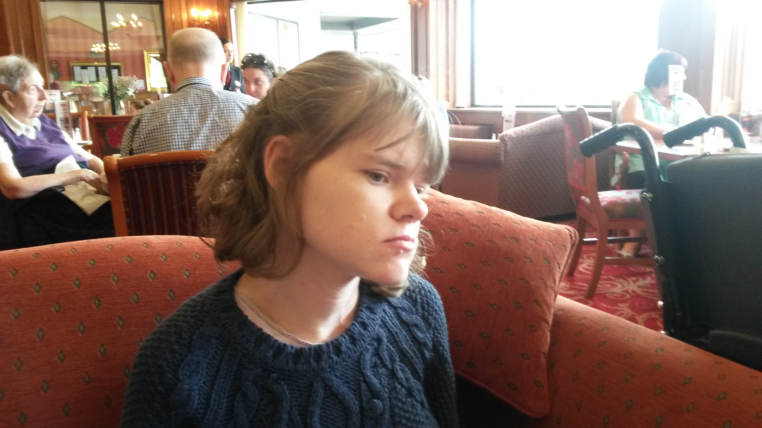

Slide 6
anthropology
vulnerability
sign
inclusion
ecclesiology
community

Slide 7
The spiritual experience of people with profound intellectual disabilities…
“what is assumed…in practice, however much we might wish to redefine what faith is, is that in order to be saved, a person will normally have language and the intellectual capacities to learn a set of beliefs and make choices and decisions about them; what is assumed is able-bodied normativity.” Morris

Slide 8
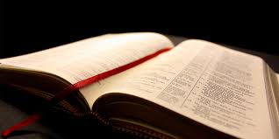
Faith comes from hearing and hearing comes by the Word of God…

Slide 9
Potential responses…
Prevenient grace
Sacrament of baptism
Age of understanding
Focus on eternal security

Slide 10
Another potential response…
Empirical evidence
Focus on spiritual experience
The elevation of the anecdote?

Slide 11
“severely mentally handicapped people are denied the very substance of a rational productive existence...Such an existence gives no real opportunity for inner spiritual growth, or the nourishment of the human spirit, both of which are important when coming to terms with the meaning of Christianity. It gives no real opportunity to experience the joy of seeking a lifetime relationship with the Almighty, because concepts involved are complicated and require a level of awareness which the profoundly mentally handicapped do not have.” Birchenall

Slide 12
“severely mentally handicapped people are denied the very substance of a rational productive existence...Such an existence gives no real opportunity for inner spiritual growth, or the nourishment of the human spirit, both of which are important when coming to terms with the meaning of Christianity. It gives no real opportunity to experience the joy of seeking a lifetime relationship with the Almighty, because concepts involved are complicated and require a level of awareness which the profoundly mentally handicapped do not have.”
Birchenall

Slide 13
Spirituality and persons with profound intellectual disabilities…
lens
…through the lens of a
‘theology of accommodation’

Slide 14
Accommodation
The provision of a room or lodgings
The process of adapting or adjusting to someone or something

Slide 15
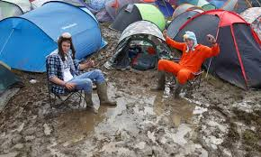
Accommodation

Slide 16
The premise of divine accommodation
God is infinite
God created human beings to be in loving relationship with himself
These human beings are finite and are therefore incapable of apprehending the infinite God – there is, humanly-speaking, an unbridgeable gap between them and God.
Because God loves us, in order to bridge this gap, He accommodates His Self-revelation to what human beings are capable of apprehending of Him.

Slide 17
Outside the biblical tradition
“the ancient Romans used the word [accommodation]...in rhetoric to express the idea that an orator would adapt himself to his audience in his choice of words, gestures and emotions so that he could move their hearts and persuade their minds in whatever direction he wanted.” Van Bemmelin

Slide 18
Accommodation within the biblical tradition
potential discrepancies within the text
differences between what God asks of humans in one period and context and what He expects in another
the fact that God chooses to use human language at all
Scriptura humane loquitor: “theology…stoops to speak the language of ordinary men."

Slide 19
“John spoke of the matter not as it is but even he, only as he was able…it was a man that spoke of God. Inspired indeed by God, but still a man. Because he was a man he said something; if he had not been inspired he would have said nothing. But because he was a man inspired, he spoke not the whole, but what a man could, he spoke.” Augustine

Slide 20
Ezekiel 20
“I gave them my decrees and made known to them my laws, by which, the person who obeys them shall live. Moreover also I gave them my Sabbaths, as a sign between us, so they would know that I the Lord made them holy.” (11-12)
“I gave them other statutes that were not good and laws through which they could not live; I defiled them through their gifts – the sacrifice of every firstborn – that I might fill them with horror so that they would know that I am the Lord.” (24-25)

Slide 21
“For who is so devoid of intellect as not to understand that God, in so speaking, lisps with us as nurses are wont to do with little children? Such modes of expression do not so much express what kind of a being God is as accommodate the knowledge of him to our feebleness. In so doing He must, of course, stoop far below His proper height.” John Calvin

Slide 22
Anthropomorphic depictions of God
“it is a well-considered design that the Holy Scripture speaks of God as of a being resembling man, and ascribes to him a face, eyes, ears…This is done out of consideration for man’s power of comprehension.”
Seisenberger

Slide 23
“so the Divine power..., though exalted far above our nature and inaccessible to all approach, like a tender mother who joins in the inarticulate utterances of her babe, gives to our human nature what it is capable of receiving and thus in the various manifestations of God to man he both adapts Himself to man and speaks in human language and assumes wrath and pity and such– -like emotions so that through feelings corresponding to our own infantile life, might be led as by the hand, and lay hold of the Divine nature by means of words which His foresight has given.” Gregory of Nyssa

Slide 24
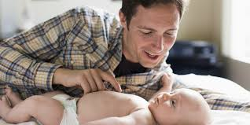

Slide 25
God’s stopping point?

Slide 26
Humility in the academies
“We try to measure God’s immeasurableness by our small measure. But it is God who knows the incalculable difference in measure between His infinity and our finiteness, and accordingly accommodates the one to the other in the way in which he reveals Himself to us.” Battles

Slide 27
The infiniteness of our ignorance
“We try to measure God’s immeasurableness by our small measure. But it is God who knows the incalculable difference in measure between His infinity and our finiteness, and accordingly accommodates the one to the other in the way in which he reveals Himself to us.” Battles
Psalm 131…

Slide 28
Humility in the academies
“Intellectual activities may lead us part of the way; they may even point to God’s existence, but God’s essence is beyond our powers of expression. Enfleshed human beings do not have the capacity to grasp God’s nature except in faithful acceptance of the mystery.” Norris
Psalm 131…

Slide 29
Contrasting God’s accommodation with ours:
An unhealthy inquisitiveness into the heart of people?

Slide 30
“The world is immense, constructed on no plan or theory which the intellect of man may grasp. The transcendent is everywhere. This is the burden of every verse. Sufficient of insufficient there is nothing more…God is great, we do not know his ways.” Rutherford
“Don’t just do something – stand there…”
Pattison

