Slide 1
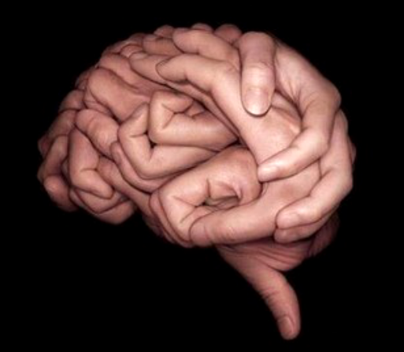
Word Become Flesh: Embodied Theology And Spiritual Encounters
Institute on Theology and Disability
Thursday, May 26, 2016
Keith Dow
Mike Friesen
Notes:
(The image on the right-hand side of this slide looks like a brain at first glance. You quickly realize that it is composed of photos of many hands, folded together.)

Slide 2
Introduction & Confession
Keith Dow
@keidow
kdow@christian-horizons.org
Mike Friesen
@mike_friesen
friesenma05@gmail.com

Slide 3
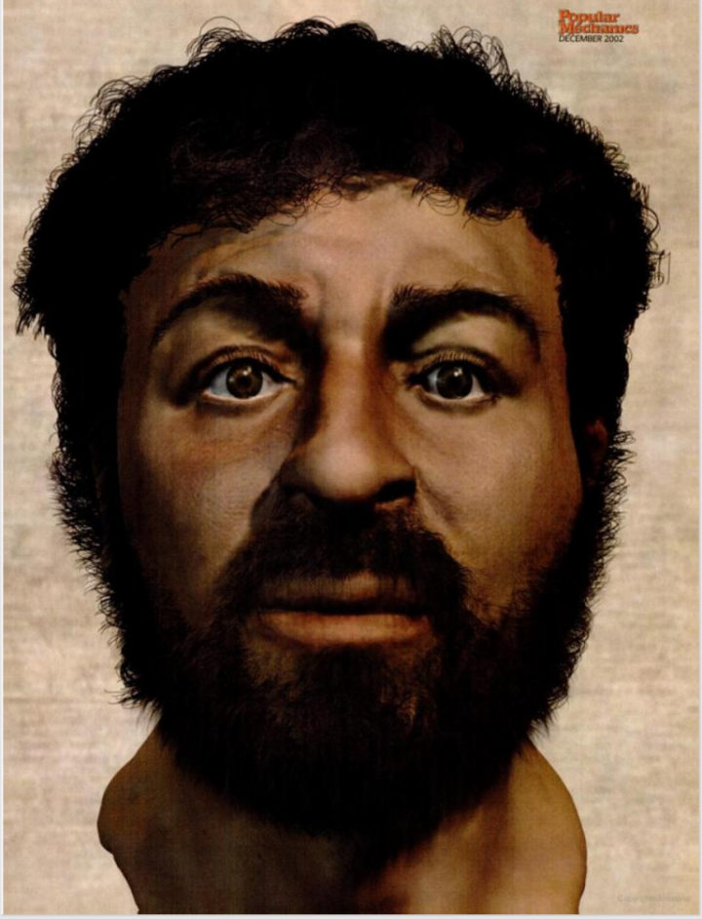
Notes:
(There is a face on this slide. It is the face of a Middle-Eastern man with a short beard and inquisitive/curious eyes. There is nothing very remarkable about the face.)

Slide 4
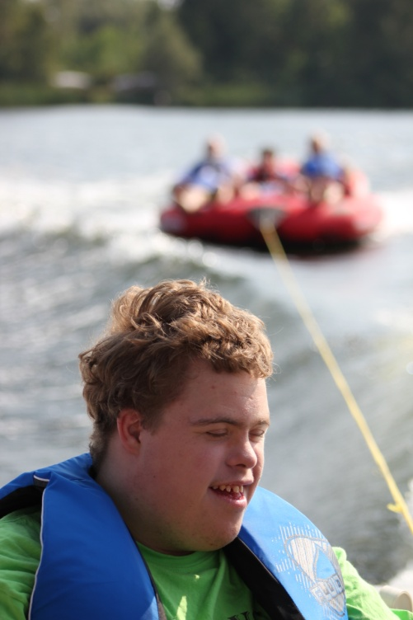
“We are to touch people with a deep respect -- to touch them with tenderness. Our hands, and not just our voices, may become vehicles of the love of Jesus. The Word became flesh, that our flesh may become word. Our flesh, through the power of the Holy Spirit, can reveal to people their value -- that they are cherished and loved by God. ~ Jean Vanier
Notes:
(There is a photo on the right-hand side of this slide. It is David, who goes to the Christian Horizons Family Retreat. David is shown in the back of a boat that is pulling a tube with three people on it. David loves being in the boat. He has a very hard time leaving when the retreat is done, and this photo shows why. He appears blissful, with the sun hitting his face and the wind in his hair.)

Slide 5
“My soul is consumed with sorrow to the point of death. Stay here and keep watch with Me.”
”Watch and pray so that you will not fall into temptation.
The spirit is willing, but the flesh is weak."
Notes:
(The image at the bottom of the slide is of Jesus, praying in the garden of Gethsemane. It is a dark, gritty painting, where Jesus’ hands are clasped in prayer on a yellow rock while his face is hidden, tucked between his arms)
“My soul is consumed with sorrow to the point of death. Stay here and keep watch with Me.”
“Watch and pray so that you will not fall into temptation. The spirit is willing, but the flesh is weak.”
(From Matthew 26)

Slide 6
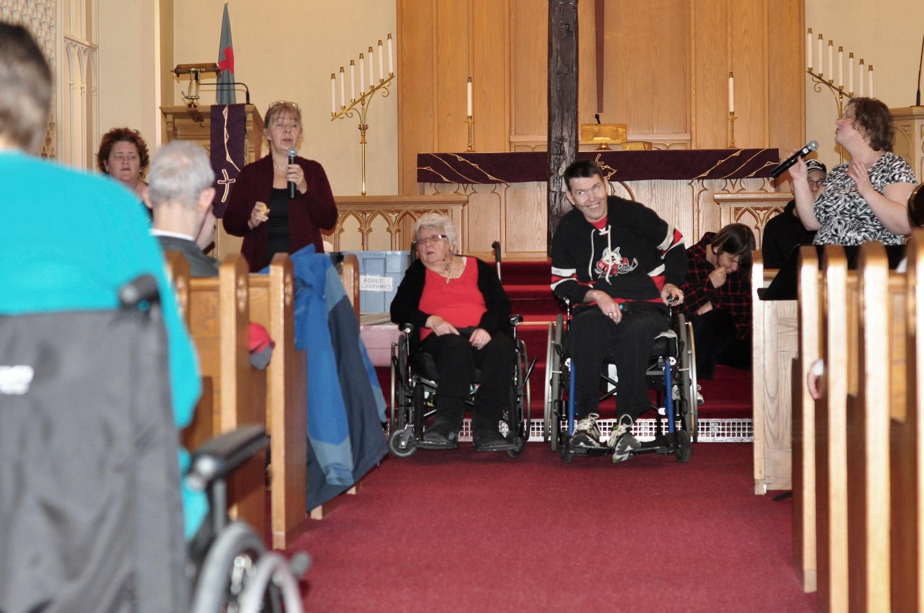
Notes:
(A photo of the SOUL program in St. Catherines, Ontario. Two people who use wheelchairs are in the middle at the front of church, with people around them singing. The church runs the SOUL program for people with intellectual and developmental disabilities three days a week.)

Slide 7
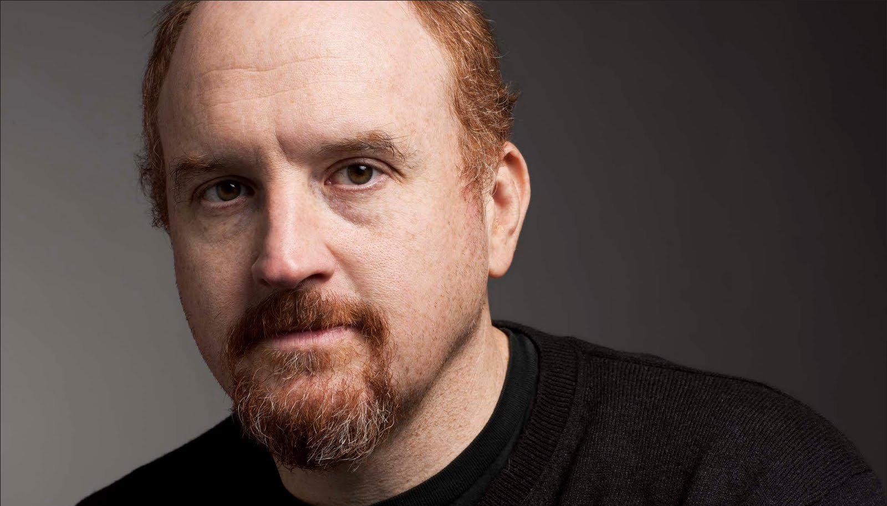
Louis C. K.
Mild Racism
Mild ableism?
Notes:
(There’s a large photo of Louis C. K. in the background. He has red hair and brown eyes and is wearing a black shirt).
Louis C. K. “Mild Racism” Mild Ableism?

Slide 8
Outline
The disease Perception Projection Protection | 2. The cure Presence Patience Participation
(disruption)

Slide 9
Outline
The disease Perception Projection Protection | 2. The cure Presence Patience Participation
(disruption)

Slide 10
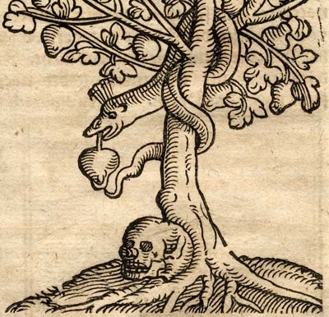
She saw that the tree was beautiful and its fruit looked delicious, and she wanted the wisdom it would give her. So she took some of the fruit and ate it. Then she gave some to her husband, who was with her, and he ate it, too.” ~ Genesis 3:6, NLT
Notes:
(The image on this slide is a black drawing of a snake wound around a fruit tree holding a fruit in its mouth, with a human skull at the base of the tree. It looks as though it is a book illustration.)

Slide 11
Beauty is in the eye of the Beholder
Perception
Notes:
(The image to the right of this side is a detailed pencil drawing of an eye. Not only does the drawing show the eye, but it shows at least twelve pencils and hands, also drawn, drawing the eye)

Slide 12
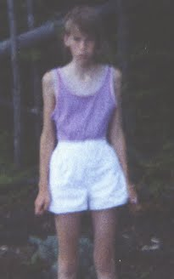
Perception
Notes:
(The image in the centre of the slide, set against a black background, is of a gaunt 9-year old girl. Emily is wearing a light purple shirt and white shorts, with a sullen face and stick-like arms and legs. In the background it looks to be a garden and trees)

Slide 13
emilywierenga.com
Perception
Notes:
(On the right hand side of the slide is a photo of the cover of “Chasing Silhouettes,” a book by Emily Wierenga.)

Slide 14
Outline
The disease Perception Projection Protection | 2. The cure Presence Patience Participation
(disruption)

Slide 15
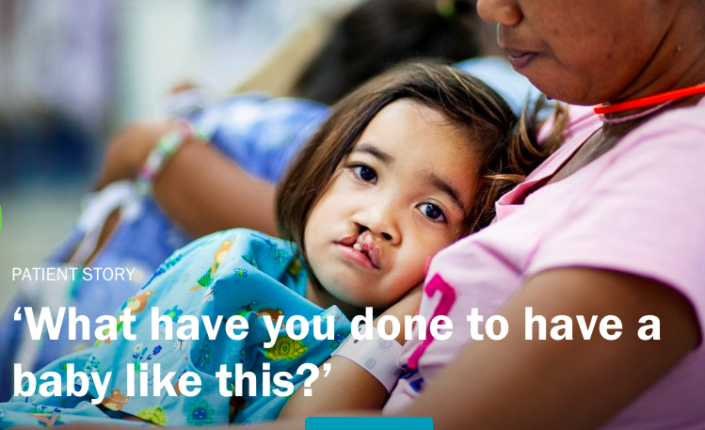
Notes:
(Image background of the slide: a young girl leans against her mother, looking at the camera. She has a cleft lip that leaves a gap from her mouth up to her nose).
Caption “What have you done to have a baby like this?”

Slide 16
Q: What are some projections/assumptions we make based on first impressions?

Slide 17
Outline
The disease Perception Projection Protection | 2. The cure Presence Patience Participation
(disruption)

Slide 18
(disruption)
“Sometimes the very unrecognizability of the other brings about a crisis in the norms that govern recognition.”
– Judith Butler

Slide 19
Q: When have your perceptions been disrupted in getting to know someone? When have you disrupted someone else’s perceptions of you?

Slide 20
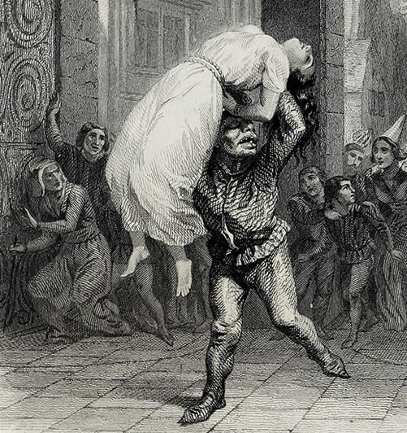
He was, in truth, bad because he was wild; he was wild because he was ugly. (IV.III.10)
Notes:
(Image shown is Quasimodo saving Esmeralda. An illustration by Aime de Lemud from a Paris edition of Victor Hugo’s “Hunchback of Notre Dame” from 1844. It is a line drawing/black and white book illustration where Quasimodo is running away from crowds who are in shock. He is carrying the beautiful Esmeralda over his head, and his own face is disfigured like a gargoyle on the side of a church with protruding eyes, a large noes, bulgy lips, and irregular teeth)

Slide 21
Notes:
(Image of the book cover of Timothy J. Basselin’s “Flannery O’Connor: Writing a Theology of Disabled Humanity. On the cover is a black-and-white picture of a young girl reading a book with curled pages).

Slide 22
Upon [the bridge] a vast horde of souls were tumbling toward heaven. There were whole companies of white trash, clean for the first time in their lives…and battalions of freaks and lunatics shouting and clapping and leaping like frogs. ~ Flannery O’Connor, Revelation
Notes:
(The background to this quite is a painting of a field of wheat with a red-orange sky in the background, looking almost as if it is on fire. On the horizon is a row of green shrubs or trees)

Slide 23
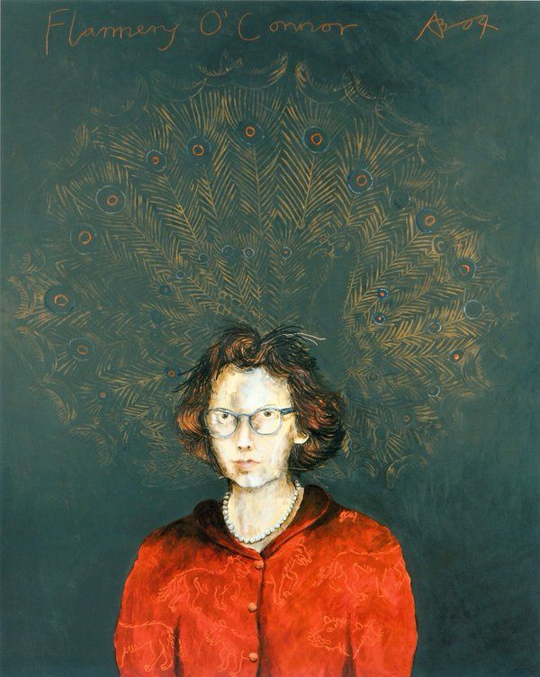
“Few have stared at [the good] long enough to accept the fact that its face too is grotesque, that in us the good is something under construction.” ~ Intro to A Memoir of Mary Ann
Notes:
(On the right of this slide is a painting of Flannery O’Connor with dark brown hair, teal glasses, pearl necklace and a red button-up jacket. The background of the painting is teal, with what looks to be peacock feathers drawn in the background.)

Slide 24
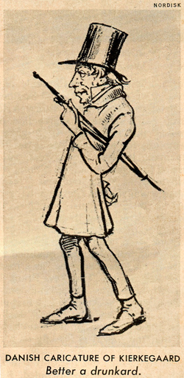
“The beloved and the friend are the immediate and direct objects of immediate love, the choice of passion and of inclination. And what is the ugly? It is the neighbor, whom one shall love. … true love is love for the neighbor, or it is not to find the lovable object but to find the un-lovable object lovable” (Works of Love, pp. 373-4).
Notes:
(On the right side of this slide is a Danish Caricature of Kierkegaard with the caption “Better a drunkard.” Kierekgaard is shown stooped backwards, with a large top hat on his head and an umbrella under his left arm, walking towards the left with his other hand behind his back. His face is wrinkled and he looks a bit ridiculous).

Slide 25
Outline
The disease Perception Projection Protection | 2. The cure Presence Patience Participation
(disruption)

Slide 26
“Now you are the body of Christ, and each one of you is a part of it.” ~ 1 Corinthians 12:27, NIV “It takes the whole Church to know the whole truth.” ~ Rowan Williams
Presence

Slide 27
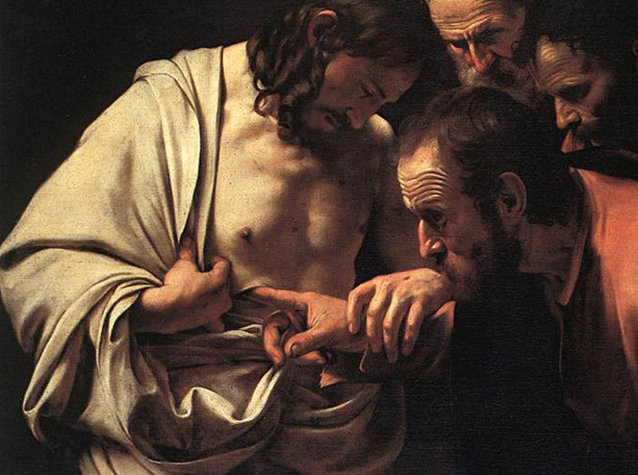
“[T]here is no goodness that is not bodily and realistic and local.” - Rowan Williams
Presence
Notes:
(The image shown in this slide is The Incredulity of Saint Thomas by Caravaggio. In it, the resurrected Christ guides Thomas’ hand into the wound in his chest. A wide-eyed Thomas does so with intense curiosity as several other disciples peer over his shoulder.)

Slide 28
Outline
The disease Perception Projection Protection | 2. The cure Presence Patience Participation
(disruption)

Slide 29
“The movement that Jesus begins is constituted by people who believe that they have all the time in the world, made possible by God’s patience, to challenge the world’s impatient violence by cross and resurrection.” ~ Stanley Hauerwas
Patience

Slide 30
Outline
The disease Perception Projection Protection | 2. The cure Presence Patience Participation
(disruption)

Slide 31
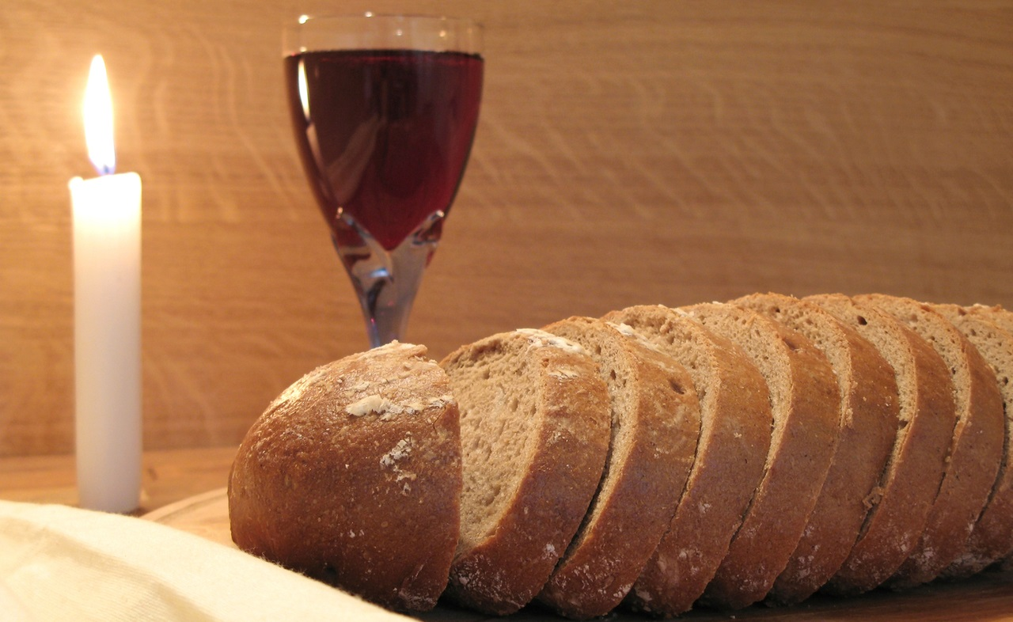
this is my body…
broken for you
Notes:
(Background image is of a white, lit candle, a glass of wine, and a loaf of bread, sliced)

Slide 32
"To consume the Eucharist is an act of anticonsumption, for here to consume is to be consumed, to be taken up into participation in something larger than the self, yet in a way in which the identity of the self is paradoxically secured“ ~ William T Cavanaugh
Participation

Slide 33
Notes:
(Image on the slide is a drawing, looking as though it was drawn on a chalkboard, of a hand reaching down with the words “Taken, Blessed, Broken, Given” written on a scroll. Underneath is written “love” and it looks as though a stream of colours is coming down in a triangle and hitting the silhouette of city buildings at the bottom)

