Slide 1
Disability and Ministry: A Biblical Exploration
Rev. Mark Stephenson
Director of Disability Concerns
Christian Reformed Church

Slide 2
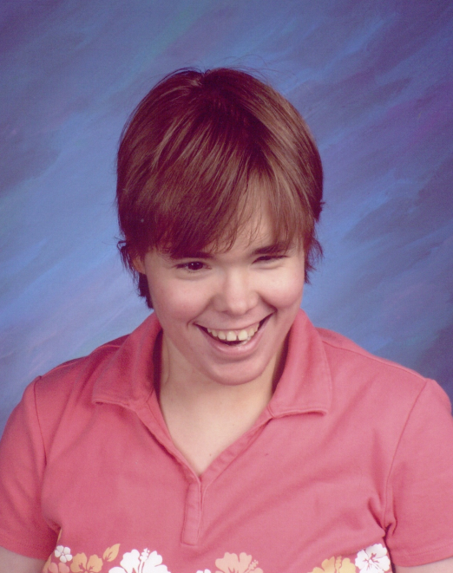
Introduction
About my family and me
Reformed tradition
About what is “normal”
About disability
“Persons with disabilities include those who have long-term physical, mental, intellectual or sensory impairments which in interaction with various barriers may hinder their full and effective participation in society on an equal basis with others.”
(Article 1: Purpose, “Final report of the Ad Hoc Committee on a Comprehensive and Integral International Convention on the Protection and Promotion of the Rights and Dignity of Persons with Disabilities,” United Nations General Assembly, A/61/611, 6 December 2006)

Slide 3
Disability and Sin
Priests: Leviticus 21:16-24 (NIV)
¹⁷The Lord said to Moses, "Say to Aaron: ‘For the generations to come none of your descendants who has a defect may come near to offer the food of his God.’”
Does this mean that people with disabilities are not welcome among God’s people?
The prohibition is limited to priests coming before the altar or entering the Holy of Holies.

Slide 4
Disability and Sin
A healing: Mark 2:1-12
⁵When Jesus saw their faith, he said to the paralytic, "Son, your sins are forgiven."
Was Jesus associating disability with sin?
Jesus is not making a point about the man’s disability, but about his own calling and the teachers’ unbelief.

Slide 5
Disability and Sin
A banquet: Luke 14:15-24
²¹Then the owner of the house became angry and ordered his servant, 'Go out quickly into the streets and alleys of the town and bring in the poor, the crippled, the blind and the lame.'
Was Jesus implying that disabled people were welcomed at the banquet only because non-disabled people would not come?
No, he was emphasizing that the wide hospitality of God’s kingdom.

Slide 6
Disability and Sin
What is the connection?
Direct: A disability is a monstrosity (from Latin monēre – to warn) which is a sign that covenant has been broken or that one does not have enough faith.
Indirect: A participation in a world marked by sin and the misery that comes with it.
None: Disabilities in humans are to be celebrated as part of the wide diversity God has made in his creation; therefore, they are not properly called “disabilities” but instead should be called “differences.”

Slide 7
Disability and Healing
A healing: Mark 10:46-52
⁵¹“What do you want me to do for you?” Jesus asked him. The blind man said, “Rabbi, I want to see.” ⁵²“Go,” said Jesus, “your faith has healed you.” Immediately he received his sight and followed Jesus along the road.
Why did Jesus heal Bartimaeus?
“ . . . to demonstrate . . . God’s salvation history.” (A Church of All and for All, EDAN, WCC, 2003)

Slide 8
The Messiah and Disability
God’s people were called to protect people with disabilities.
Do not curse the deaf or put a stumbling block in front of the blind, but fear your God. (Leviticus 19:14)
Jesus surrounded himself with people who had disabilities.
Jesus reached out his hand and touched the man [with leprosy] . . . (Luke 5:13)

Slide 9
The Messiah and Disability
The Suffering Servant: Isaiah 52:13-53:12
His appearance was so disfigured beyond that of any man and his form marred beyond human likeness.
“This vision of the messiah is almost the photo-negative of the image of the priest in the Torah. The messiah is ritually impure (the disease, it is inferred, is leprosy which makes one ritually impure), excluded from society, sitting outside one of the city’s gates while the priests are allowed inside God’s sanctuary. Though physically blemished and ritually impure, this is the one through whom redemption will come.”
(Rabbi Judith Z. Abrams, “Misconceptions about Disabilities in the Hebrew Bible,” Journal of Religion, Disability & Health, Vol. 10. No. 3/4, p. 84.)

Slide 10
The Messiah and Disability
Jesus’ resurrection body: Luke 24:36-49
Look at my hands and my feet. It is I myself! Touch me and see; . . .
“In presenting his impaired body to his startled friends, the resurrected Jesus is revealed as the disabled God. Jesus, the resurrected Savior, calls for his frightened companions to recognize in the marks of impairment their own connection with God, their salvation.”
(Nancy Eiesland, “Liberation, Inclusion, and Justice: A Faith Response to Persons with Disabilities,” Impact, Volume 14, No. 3, Winter 2001/02, downloaded January 2, 2008, from http://ici.umn.edu/products/impact/143/over02.html)

Slide 11
The Body of Christ
All people are created in the image of God; therefore, each person has intrinsic value not based on what she can do but on who she is.
“Then God said, “Let us make humankind in our image . . . ” (Genesis 1:26)

Slide 12
The Body of Christ
Jesus’ body, the church, has many parts but is ONE; therefore, each member of Christ’s body (each person) is essential for a healthy church.
“The body is a unit, though it is made up of many parts; and though all its parts are many, they form one body. So it is with Christ. . . . those parts of the body that seem to be weaker are indispensable.” (1 Corinthians 12:12, 22)

Slide 13
The Body of Christ
All believers are called by God; therefore, each believer has a mission given by God to fulfill while here on earth.
“For we are what [God] has made us, created in Jesus Christ for good works, which God prepared beforehand to be our way of life.” (Ephesians 2:10)

Slide 14
The Body of Christ
All believers have spiritual gifts; therefore, each believer receives from God the gifts he needs to accomplish this mission.
“Now there are varieties of gifts but the same Spirit . . . ” (1 Corinthians 12:4)

Slide 15
The Body of Christ
All believers are invited to participate in God’s work; therefore, every member of Christ’s body fulfills an essential and unique function in the body.
“To each is given the manifestation of the Spirit for the common good . . . ” (1 Corinthians 12:7)

Slide 16
The Body of Christ
In healthy churches, everybody belongs.
“Above all, love each other deeply, because love covers over a multitude of sins. Offer hospitality to one another without grumbling.” (1 Peter 4:8-9)
In healthy churches, everybody serves.
“Each one should use whatever gift he has received to serve others, faithfully administering God's grace in its various forms.” (1 Peter 4:10)

Slide 17
Barriers to Inclusion
Architectural
Communication
Attitude

Slide 18
Inclusion of Every Part
Caring
Gifts
Education
Outreach
Worship

Slide 19
Inclusion of Every Part
The inclusion of people with disabling conditions is essential in congregations and parishes because they are children of God and children of the Church, whom the Church would not choose to be without. People with disabling conditions challenge and excite our collective imagination in the multitude of ways that we may be a more caring, compassionate community of Christians.
Brett Webb-Mitchell, Unexpected Guests at God’s Banquet: Welcoming People with Disabilities Into the Church (New York: Crossroad, 1994)

Slide 20
For Further Information
crcna.org/disability (enewsletter subscriptions)
rca.org/disability
clcnetwork.org/church
faithanddisability.org
friendship.org
Journal of Disability and Religion
Inclusion Handbook, ed. Terry A. DeYoung and Mark Stephenson
A Compassionate Journey: Coming Alongside People with Disabilities and Chronic Illnesses by John G. Cook

