Slide 1
Tell a New Story
The Impact of Language in the Stories We Tell and the Resulting Perceptions of People with Disabilities

Slide 2
Learning Objectives
1. Develop a framework for understanding the evolution of language in storytelling
2. Recognize the power of the motive for telling the story
4. Examine the story of 'Blind Bartimeus’ as a story of
empowerment
5. Consider the questions: Who is the hero? Whose story is it to tell?

Slide 3
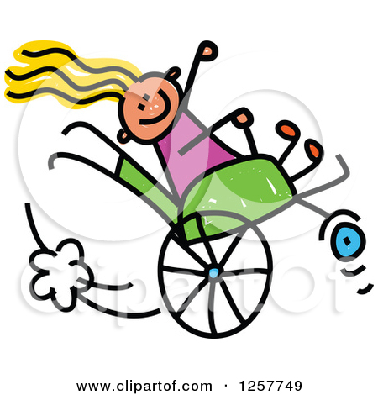
Communication has meaning
Disabled
Non-disabled
Normal
Whole
Suffer
Healing
Cure
Talented
Blessing
Burden
Let, allow
Notes:
Two images- 1. top image of a stick figure seated in a wheelchair, smiling, long blond hair streaming behind her with a puff of “exhaust fume” and movement lines at the back of the wheelchair as the person seated in the wheelchair pops a wheelie; 2. lower image is a sketch of a faceless person seated in a wheelchair, person seated in the wheelchair has bandages around his head and his arm in a sling, a faceless female figure is pushing the wheelchair.
Motive- why do we choose the words we use when telling stories? Persuaion, opinion, connecting, inform, change behavior, motivate, emotion, sell, create a need, morality, make complex simple

Slide 4
Why Do we tell stories?
Teach
History
Seeking employees and supporters
Fund raising
Inspire, motivate
Morality influence (Aesop’s Fables)
Illicit an emotional reaction
Change behavior
Change thought patterns
Influence
Express opinion

Slide 5
⁴⁶They came to Jericho. As he and his disciples and a large crowd were leaving Jericho, Bartimaeus son of Timaeus, a blind beggar, was sitting by the roadside. ⁴⁷When he heard that it was Jesus of Nazareth, he began to shout out and say, “Jesus, Son of David, have mercy on me!” ⁴⁸Many sternly ordered him to be quiet, but he cried out even more loudly, “Son of David, have mercy on me!” ⁴⁹Jesus stood still and said, “Call him here.” And they called the blind man, saying to him, “Take heart; get up, he is calling you.” ⁵⁰So throwing off his cloak, he sprang up and came to Jesus. ⁵¹Then Jesus said to him, “What do you want me to do for you?” The blind man said to him, “My teacher, let me see again.” ⁵²Jesus said to him, “Go; your faith has made you well.” Immediately he regained his sight and followed him on the way.
Notes:
Image description- stone or clay relief image of a square stone frame around an image of the same material; There are two bearded men with long hair and wearing tunics suggestive of a mid-eastern style. One man has his hands on the forehead and eyes of the other man; there is a leafy tree and horizon line in the background. The only color is that of the stone material the relief is made from.
Note regarding image- I found this using a Bing search with the key words “Bartimaeus,” “healing.” It seems to have originated from the University of Michigan, but no citations were attached to it. If this image is yours or you know any details about where it originated from please contact this author and it will be removed or proper citation added.

Slide 6
Toby the Therapy Cat
Watertown Daily Times
February 23 ·
Toby, now 10 months old, has found a forever family with Hayes and a growing career as a companion for older adults with dementia and other health issues. His “play dates” regularly take him to Charles House and other senior communities. Toby is “curious and affectionate,” family friend Carla Shuford said. “It’s the perfect combination for a therapy cat.” He’s also blind. (via McClatchy Newspapers)
Notes:
Image of a smiling young blond woman and a white haired older woman. The younger woman is holding a grey and white striped cat as the older woman pets the cat; the cats eyes appear to be closed.

Slide 7
Toby the Blind Therapy Cat
Toby — a blind therapy cat — uses other senses to navigate his world
MCCLATCHY NEWSPAPERS
PUBLISHED: MONDAY, FEBRUARY 22, 2016 AT 12:30 AM
Notes:
Same image as previous slide- Image of a smiling young blond woman and a white haired older woman. The younger woman is holding a grey and white striped cat as the older woman pets the cat; the cats eyes appear to be closed.

Slide 8
Doing well or dirt poor?
The ideas I want to plant in your mind will shape the story I tell
Notes:
Image- interior of a structure with hard packed dirt floor, mud brick walls extending up to the 3 foot height with loosely fitted planks of wood that have 1-2 inches of space between most of them with sunlight shining through them; there is a narrow rectangular shaped opening 3 feet x 6 inches) above the woodstove, near the ceiling. There is a cement block, rectangular wood stove with a small surface protruding about 9 inches near the base. The protruding surface appears to have ashes, a partially burnt piece of wood, a plate and a fire poking tool lying on it. An opening for inserting the wood adjoins the protruding surface at the front of the stove. There are two pots on the top of the wood stove, one pot has a lid on and the other pot’s lid is sitting next to it on the heated surface. There is smoke coming out of the side vent of the woodstove and the smoke vents into the house with no chimney. There is a green plastic crate upside down next to the woodstove. There is a sling back wood chair to the right of the stove and an empty pop bottle on the floor. There are some pieces of wood between the stove and the wall.
http://lifehacker.com/5965703/the-science-of-storytelling-why-telling-a-story-is-the-most-powerful-way-to-activate-our-brains (Hasson, Princeton), accessed online 5.2016

Slide 9
Whose story is it?
My story?
Your story?
Community’s story?
Which community’s story?
Who tells the story?
Who is the hero?
Who owns the story?
Notes:
Image-

Slide 10
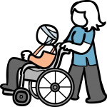
We tell stories for a reason
Some stories enhance life;
Other degrade it.
So we must be careful
About the stories we tell,
About the way we define
Ourselves and other people.
~ Burton Blatt
Notes:
Same two images as a previous slide- people using wheelchairs
1. Burton Blatt quote- [Burton Blatt, 1987 cited by O’Brien and Mount, 1191, p. 89]
2. “Think about the stories we tell and the stories we should tell” (The Relational Basis of Empowerment, by Karl Nonkoosing and Mark Hayden-Laurelut; edited by John O’Brien and Simon Duffy) forward, pg 7 online CCLD 1.2014
3. “In order to change stories of intellectual disabilities we need to change the stories our work tells about them and about us.” Nunkoosing and Haydon-Laurelut, The Relational Basis of Empowerment, University of Portsmouth, 2013, p. 33.

