Slide 1

DID THEY READ THE RIGHT SIGNS?
DISABILITY IN THE CATHOLIC TRADITION SINCE VATICAN II
DR ZACHARIAH DUKE
Notes:
This is the first page. I am making notes about it that only I can see

Slide 2

OUTLINE
1
Vatican II
2
Disability in the Catholic Tradition since Vatican II
3
The Influence of Pope Francis

Slide 3
PART ONE
VATICAN II

Slide 4
Announced in 1959 by Pope John XXIII
Preparatory phase: 1960 – 1962
  “What would you like to Council to consider?”
Council: 1962 – 1965

Slide 5

Renew and refresh

Slide 6
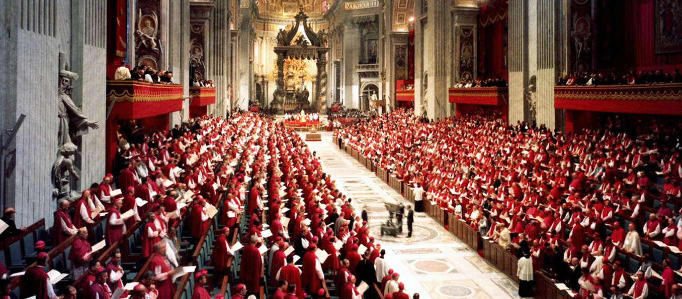
The Signs of Our Times

Slide 7
PART TWO
DISABILITY IN THE CATHOLIC TRADITION SINCE VATICAN II

Slide 8
Catholic Social Teaching
  All human beings have an inherent dignity, and all human beings should be treated equally

Slide 9

“
Created in the image and likeness of God
Gen. 1: 26 - 27
“

Slide 10
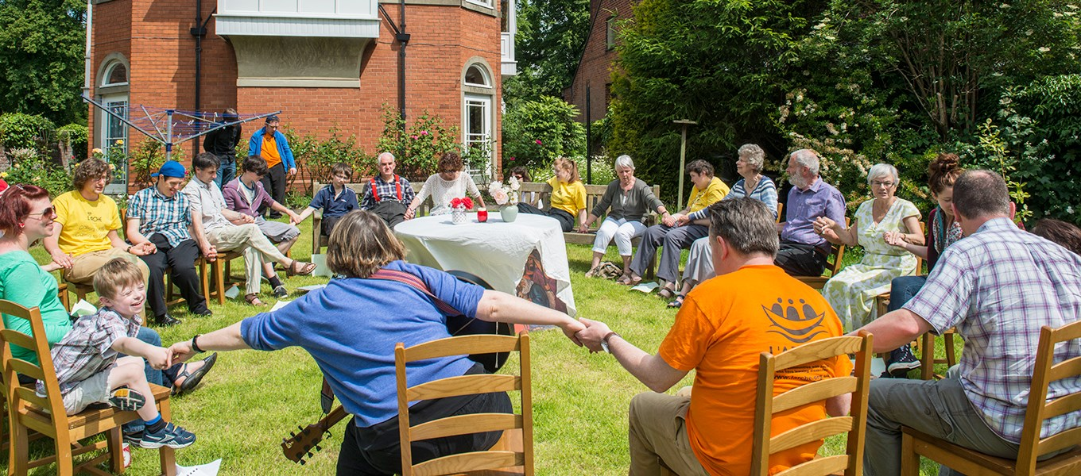
Community

Slide 11

Sacrament
Add Text, an Image, or Both

Slide 12
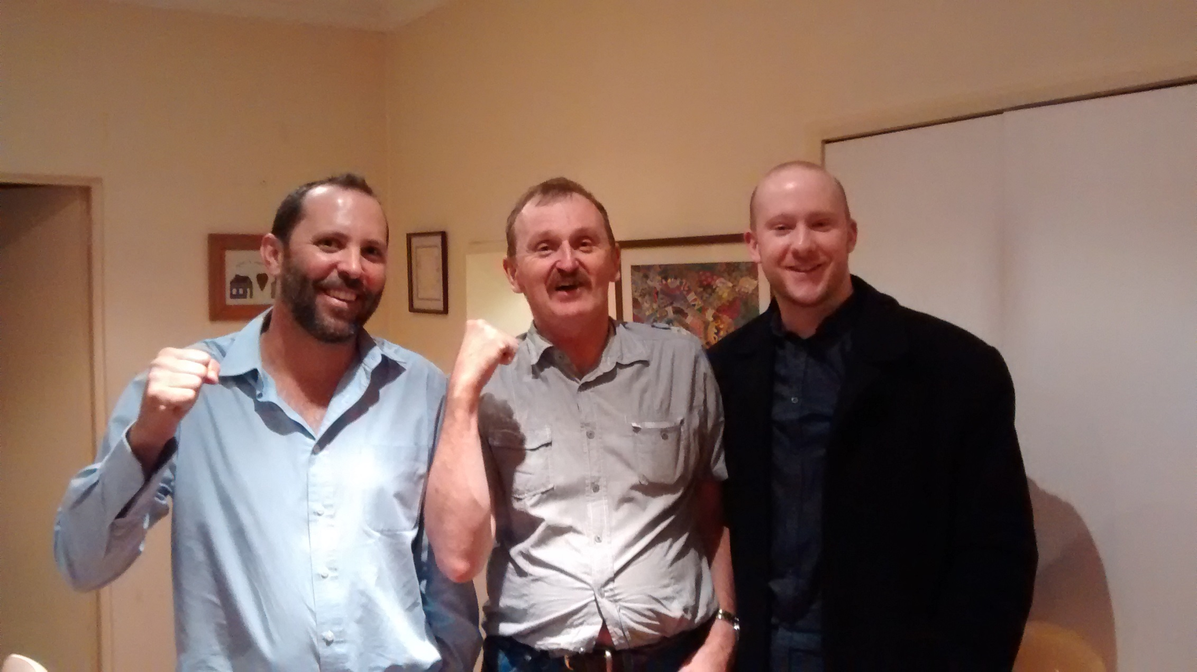
Common Good

Slide 13
PART THREE
THE INFLUENCE OF POPE FRANCIS

Slide 14


Slide 15
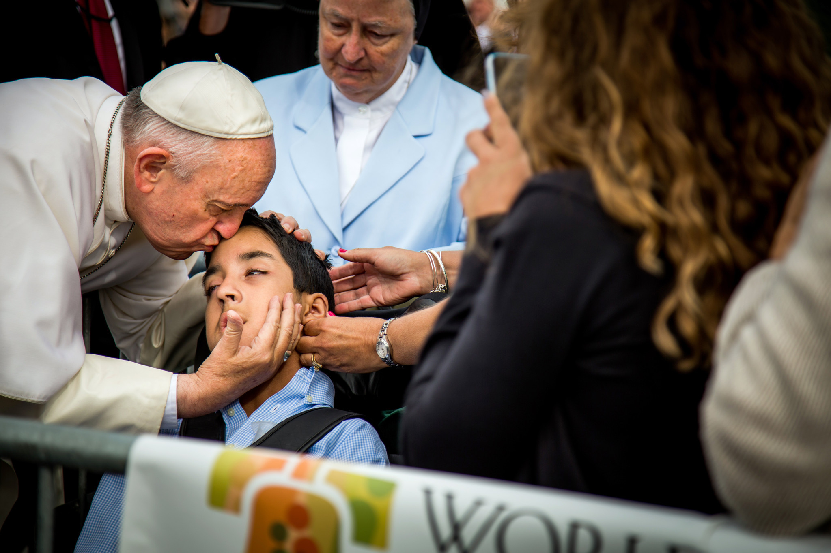

Slide 16
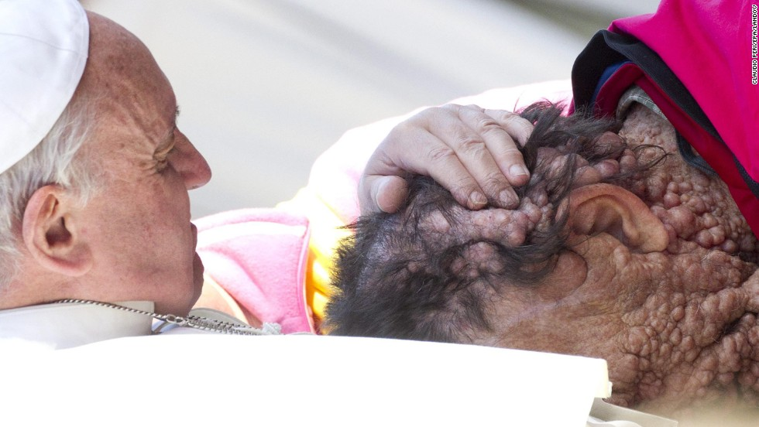

Slide 17
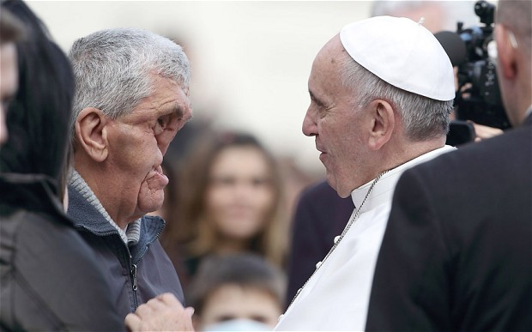

Slide 18
THANK YOU

